Slide 1
The PlayDateApplication
Dogs need some eHarmony also

Slide 2
Elevator Pitch
Dogs are human’s best friend.
Just like us, they thrive through socialization with old friends and new friends.
PlayDate connects your dog with
other dogs in the area.

Slide 3
Table of contents
01
02
Concept
Process
03
04
Demo
Future Development

Slide 4
01
Concept

Slide 5
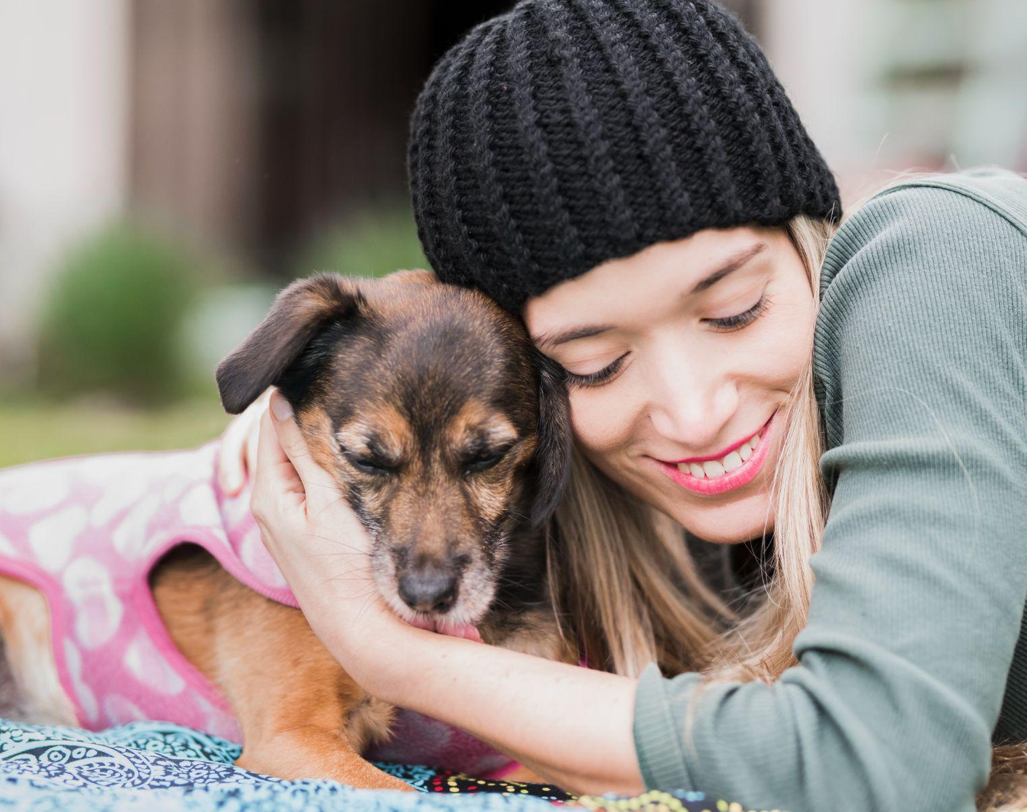
Why use PlayDate?
Description: Application that connects dog owners with other dog owners via Events.
Motivation for development: We have pets and PlayDate helps connect our pups with new pup buddies.
Simple application
We have dogs
Would use PlayDate for our dogs
User Story: Jane is new to the area and looking to meet new friends for her puppy Stella. Jane can make a new play date event and view other events.

Slide 6
02
Process

Slide 7
Technologies utilized
Express
Cloudinary Axios Google searchAPI
Formidable
Sequelize
MySQL
JShint dotenv
Fileupload
Handlebars
Session
bcrypt
flaticon, paint, sai - icons
Connect session sequelize

Slide 8
Our Team
Cloudinary
Controller
Andre
Claire
Myles
Myles
Api Routes
Controllers
View Routes
Parks API
Model
View
Entire
Team
Database
Models
Seeds
Handlebars
Styling
JavaScript
Claire & MaSandra

Slide 9
Successes & Challenges
Model - Masandra
Success | Challenge
Creation of error messages | Adjustments
API – Andre & Claire
Success | Challenge
CRUD for Events, Dogs, and Comments | Cloudinary / Google
View - Claire
Success | Challenge
Custom Helpers | Dynamic elements (ex: age)
Peter the dog | Loves playing fetch with his buddies at the park
Notes:
Myles – Backend challenges/successes

Slide 10
04
Demo

Slide 11
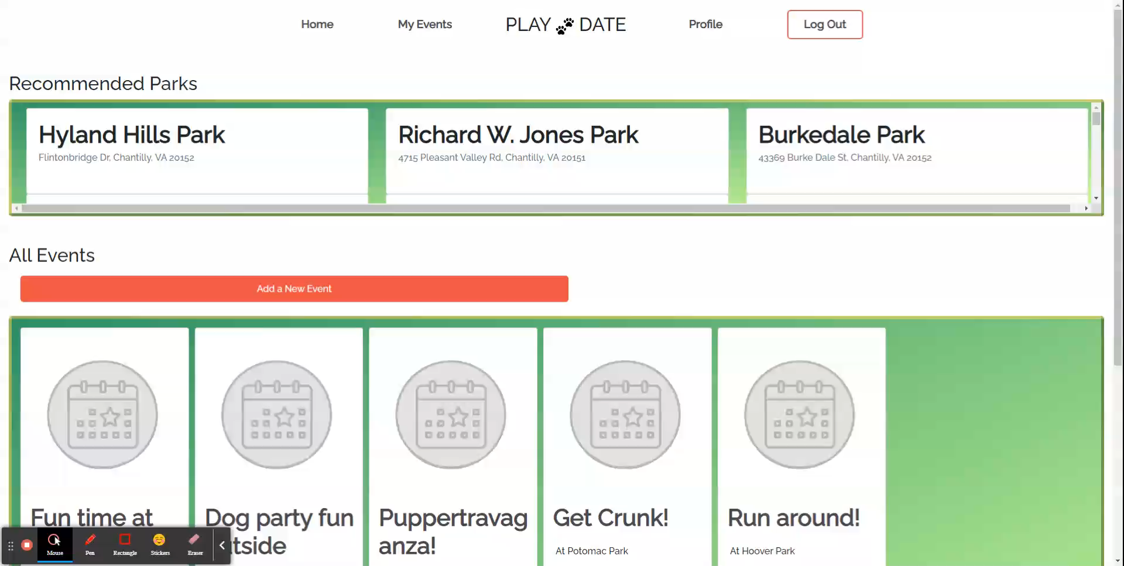
PlayDate demo

Slide 12
04
Future Development
Notes:
Speakers Notes:
Adoption Tab – make events that span over several days for adoption events

Slide 13
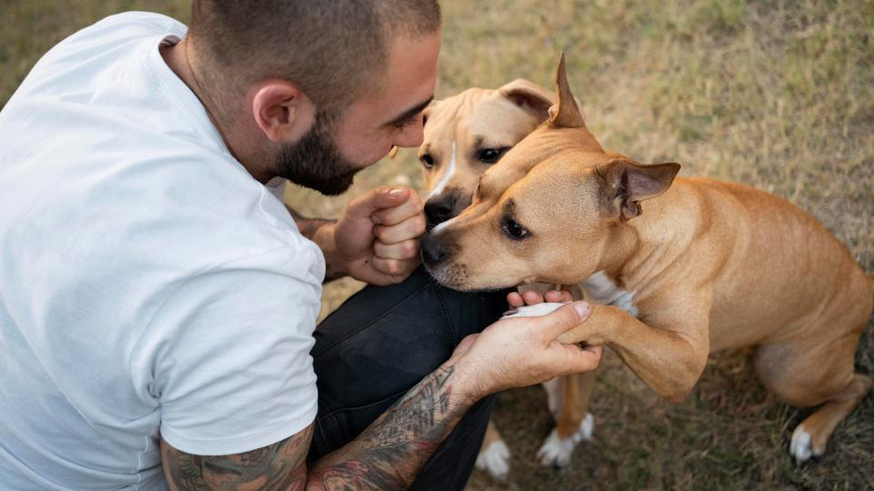
Links https://github.com/smithm4949/PlayDate https://boiling-temple-57076.herokuapp.com/profile

Slide 14
Thanks!
Do you have any questions?
Reach us at our GitHub Accounts
Claire Lee
leeclaire156
Myles Smith
smithm4949
MaSandra Ewing
mewing0328
Andre Brahin
VenBak

Slide 15
Icon pack

Slide 16
Fonts & colors used
This presentation has been made using the following fonts:
Gorditas
(https://fonts.google.com/specimen/Gorditas)
Roboto
(https://fonts.google.com/specimen/Roboto)
#554232
#da5f70
#f6e1db
#472740
#ffffff
#ed9acf
#783026
#f3be56
#579a89
#57b889

